Slide 1
HTML – Continued..
Instructor: Manu Peethambar
E-mail: cm13055@umbc.edu
Telegram handle: @manupeethambar888
Slides: https://github.com/manupeethambar888/webdev

Slide 2
HTML Input Types
<input type="text"> defines a one-line text input field.
<input type="password"> defines a password field.
<input type="submit"> defines a button for submitting form data to a form-handler.
<input type="reset"> defines a reset button that will reset all form values to their default values.
<input type="radio"> defines a radio button.
<input type="checkbox"> defines a checkbox.
<input type="button"> defines a button.

Slide 3
HTML 5 Input Types
<input type="color"> is used for input fields that should contain a color.
<input type="date"> is used for input fields that should contain a date.
<input type="datetime-local"> specifies a date and time input field, with no time zone.
<input type="email"> is used for input fields that should contain an e-mail address.
<input type="file"> defines a file-select field and a "Browse" button for file uploads.
<input type="month"> allows the user to select a month and year.
<input type="number"> defines a numeric input field.

Slide 4
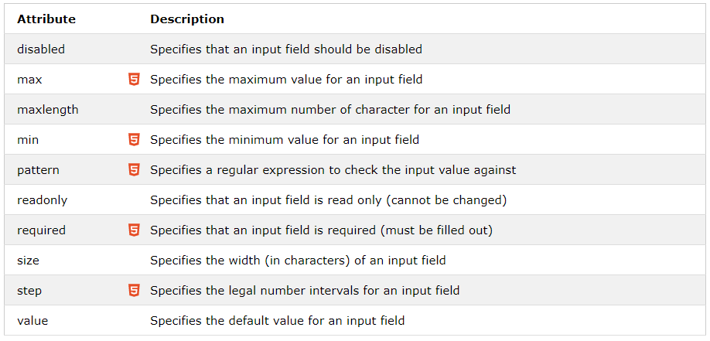
Input Restrictions

Slide 5
More Input Types
<input type="range"> defines a control for entering a number whose exact value is not important (like a slider control). Default range is 0 to 100. However, you can set restrictions on what numbers are accepted with the min, max, and step attributes.
<input type="search"> is used for search fields (a search field behaves like a regular text field).
<input type="tel"> is used for input fields that should contain a telephone number.
<input type="time"> allows the user to select a time (no time zone).
<input type="url"> is used for input fields that should contain a URL address.
<input type="week"> allows the user to select a week and year.

Slide 6
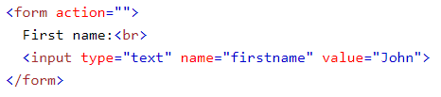
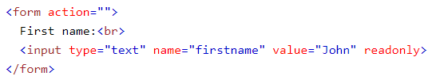
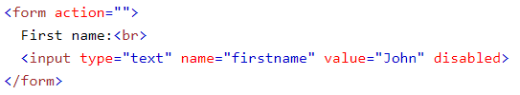
HTML Input Attributes
The value Attribute
The readonly Attribute
The disabled Attribute

Slide 7
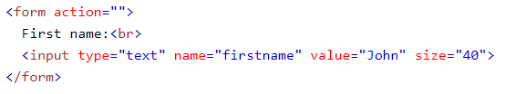
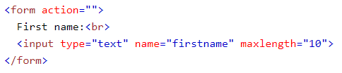
HTML Input Attributes
The size Attribute
The maxlength Attribute
More HTML5 input attributes:
Practice: https://www.w3schools.com/html/html_form_attributes.asp

Slide 8
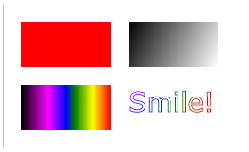
HTML5 Canvas
The HTML <canvas> element is used to draw graphics on a web page.
The graphic to the right is created with <canvas>. It shows four elements: a red rectangle, a gradient rectangle, a multicolor rectangle, and a multicolor text.
What is HTML Canvas?
The HTML <canvas> element is used to draw graphics, on the fly, via JavaScript.
The <canvas> element is only a container for graphics. You must use JavaScript to actually draw the graphics.
Canvas has several methods for drawing paths, boxes, circles, text, and adding images.

Slide 9
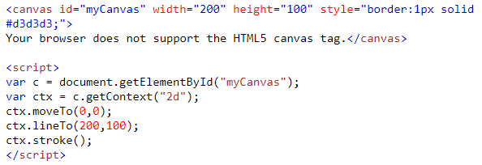
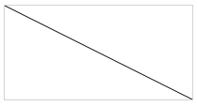
Canvas Examples
A canvas is a rectangular area on an HTML page. By default, a canvas has no border and no content.
Draw a Line

Slide 10
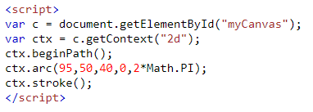
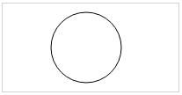

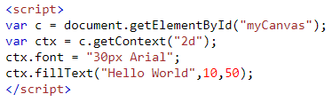

Canvas Examples
Draw a Circle
Draw a Text
Stroke Text

Slide 11
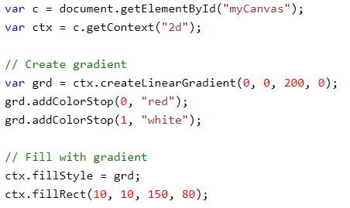
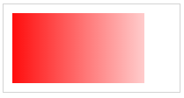
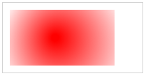
Canvas Examples
Draw Linear Gradient
Draw Circular Gradient

Slide 12

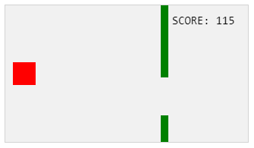
Canvas Uses
Canvas Clock: https://www.w3schools.com/graphics/tryit.asp?filename=trycanvas_clock_start
HTML Game: https://www.w3schools.com/graphics/game_intro.asp

Slide 13
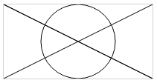
Assignment 7 due – 7/5/2018
Create a sample html file.
Create a canvas to output the drawing below:
Save this as “assignment7.html” in Homework folder in your repository “Assignments_yourname”.
Commit and push the changes to the repository.

Slide 14
Exam 1 – 7/5/2018 (Thursday)
Study all Day1 through Day7 slides:
https://github.com/manupeethambar888/webdev
Practice all the concepts taught on www.w3schools.com try it editor.

